Slide 1

Let’s Get Paid!
Co-designing a
Lived Experience Pay Equity Scale
(Part 1)

Slide 2


Antonietta Gutierrez & Rhiannon Thomas
Pathways to Peers Peer Support Worker & Program Manager
Schwartz/Reisman Emergency Medicine Institute, Mount Sinai Hospital, Toronto

Slide 3
Raise your hand!
How many people in this room feel like they get paid enough (are adequately compensated)?
How many people in the room are contract workers?
How many people in the room are permanent full-time salaried workers?
How many people in the room get yearly pay increases?
How many people have benefits (like health coverage from your employer, not from disability or other social supports)?
How many people feel like they have job security?
How many people are doing the same work as colleagues who are not hired for lived experience, but get paid less?
Notes:
Let’s do a temperature check!
This warm- up is for people who are in roles where they are hired for their lived experience – like peer support workers – not managers, directors, researchers

Slide 4
Scope and limitations of this workshop
We cannot cover every peer support role
People in the room represent diverse organizations with varying funding models, governance models and pay structures
The goal of this workshop is to equip everyone with knowledge and tools to support collective advocacy efforts
Notes:
It would be impossible to create a pay equity plan given how many different places people are here from, but we can start to get some ideas out about how we can work together to improve pay equity.
We will be going through a lot of information pretty fast so we can get to the fun part of working together and talking through some of the things we are covering. We will have time for questions, but feel free to ask questions if you can’t wait or hold them!

Slide 5
What is Pay Equity?
Pay equity is internationally recognized as a fundamental human right.
Pay equity is about "equal pay for work of equal value".
This means that if two different jobs contribute equal value to an employer’s operations, then the employees in those jobs should receive equal pay.
The idea of "equal pay for work of equal value" is similar to the idea of comparing apples to oranges – although they are different, they are equally nutritious.*
Example: If you compare the value of a truck mechanic job class (commonly held by men) to that of an account technician job class (commonly held by women), both jobs are different, but are of equal value to the company – therefore they should be compensated equally.
Similarly, within a factory, an administrative assistant job (typically a female job) may hold the same value as a machinist job (typically a male job). In this case, the compensation offered should be the same for both jobs.*
*Canadian Human Rights Commission: https://www.chrc-ccdp.gc.ca/individuals/pay-equity/about-pay-equity
Notes:
Pay equity conversations internationally started in the 50s at the Equal Renumeration convention at the United Nations as a response to the increase in women into the paid labour force.
If you’re interested in learning more about the International Labour Organization of the UN, check out their website, and in particular, you can look up by country what protocols and conventions they have not ratified – very interesting!

Slide 6
Side note: Intersectionality
Canada’s Pay Equity Act - 2021!
Gender wage gap limitations
Other wage gaps:
  Education
  Immigration & credentials outside of Canada
  Indigenous people on & off reserve
  Low-income occupations (and COVID-related job losses)
  Racialized women/people
  People with disabilities
  Neurodivergence vs. Neurotypicality
Notes:
The pay equity act in Canada was passed in 2018 but only officially came into force in 2021, and was introduced to improve the gender wage gap
As of 2022 (according to Canadian Women’s Foundation), women still only make 71% of what men make – and this only looks at the gender binary
But that’s not all – because we know well that there are many other factors that affect wage gaps –for example, Canadian institutions often don’t recognize university training from other countries, and employers often want “Canadian experience”. Or that low-income occupations are more likely to have higher representations of women/racialized women, and we also know very well who struggled the most with COVID layoffs, and the CERB pay-back.
Info here is from:
https://lmic-cimt.ca/equal-pay-day-exploring-wage-disparities-in-canada/
Stats Can

Slide 7
Systemic Barriers to Pay Equity
Working for Workers Act (4 & 5) , Jan 1, 2026
  Mandatory Compensation disclosure (incl. range & bonuses) for positions paying less than 200k
  AI & vacancy disclosure, Canadian experience ban, interview follow-up
  Does not apply to employers with 25 employees or less
Cultural: “unprofessional” to talk about pay
Notes:
We always have to remember who benefits from not disclosing pay: people who get lots of it. The more money people make, the less comfortable they are talking about it around people who make less. That’s not about confidentiality or being professional: that’s about making people in power feel more comfortable about retaining their power
Ontario will have this new act in effect next January – keep an eye out for developments

Slide 8
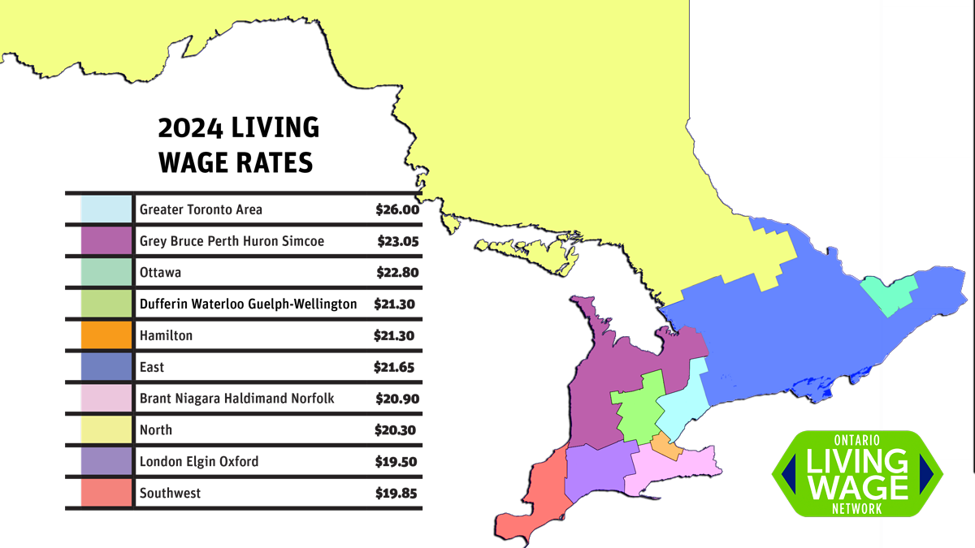
Ontario Living Wage Network
https://www.ontariolivingwage.ca/updated_2024_living_wage_rates
Notes:
Consider what does your pay look like compared to this chart
For jobs that are excluded from the Working for Workers act – 200k is ~110$/hr

Slide 9
Peer Support Role Drift
“Over the last decade, we have observed troubling trends in how peer support in the mental health and addiction sector is understood, funded, organized, and practiced. Some peer support initiatives have remained self-governed and adequately resourced and supported to maintain fidelity with peer support values. Others have not. In some contexts, peer support has been quite successful in shifting the dominant values of the mental health system (Fisher, 1994). In others, the system has done more to shift the values and role of peer supporters. We worry that in the process of expanding access to peer support in mainstream mental health and addiction services, we are losing our politicized roots in social movement histories and inadvertently reinforcing — rather than reforming — the power (and potential harm) of the psychiatric system. We are concerned that we may be enacting the very same practices that the consumer/survivor and drug user movements worked so hard to oppose a generation ago.” - PeerWorks
Drift from Peer Support Values and Standards: A Position Statement and Call for Action
Notes:
- You’ll hear more about this later today from Peer Support Canada & PeerWorks.
Peer support and mutual aid come from rights movements – the disability movement, civil rights, Indigenous rights, and others.
Mental health peer support developed from psychiatric consumer/survivor movements, and harm reduction peer support came out of drug user activism.
We take care of each other because we have to.
Health, legal and social systems were not built to receive feedback from the people that have to use them.

Slide 10
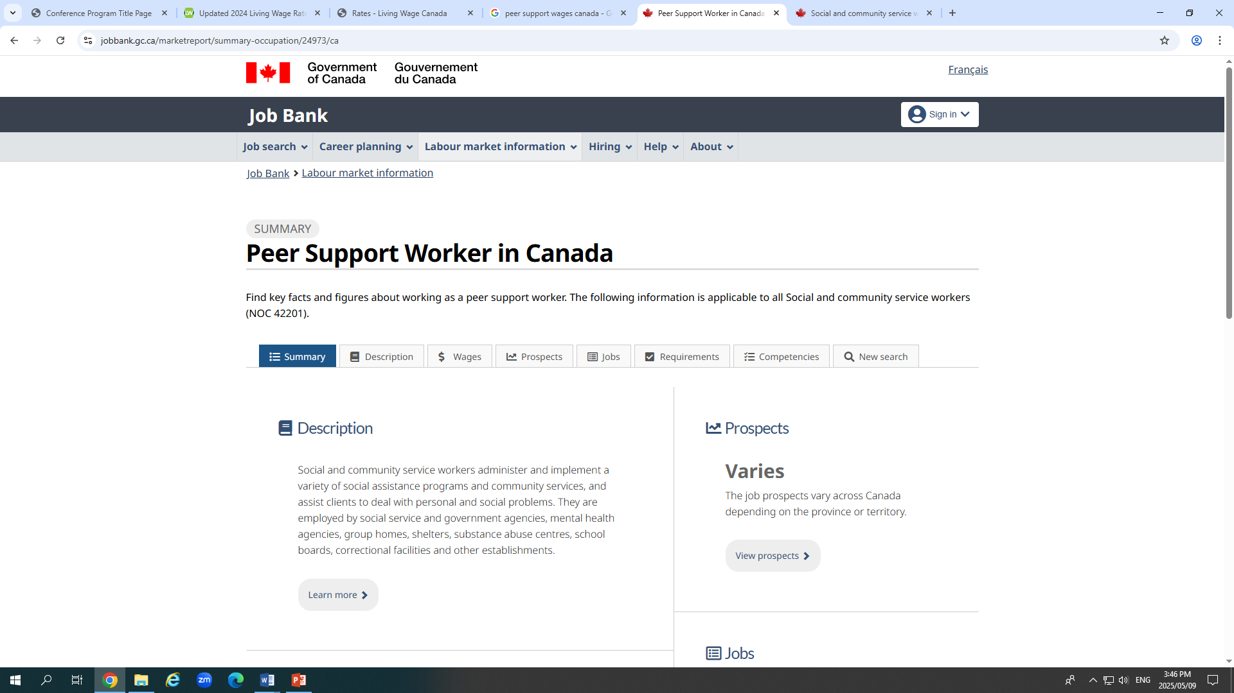
Side note: What we found online
https://www.jobbank.gc.ca/marketreport/jobs/24973/ca
Notes:
And another side note: we did a search for peer support jobs online, and the Government of Canada’s Job Bank lists peer support worker, but all the jobs listed are social service worker or community health worker kind of jobs.
Allison also mentioned in COP- compare the different between the pay of a PSW & Environmental Services in a Hospital (???)

Slide 11
Barriers for Pay Equity for Peer Support
Always fighting to prove value of PSW (product of capitalist neo-liberal policies)
Finding how to compare competencies needed for PSW and putting $ value on it
Notes:
- There are two competing forces that happen for Pay Equity for Peer support: proving the value of the work for institutions/systems that don’t understand it, and on the other side (and this is what we want to focus on here) how we can use existing frameworks that put monetary value on work to get an equitable wage for the work.
- We know that infantilization and the tokenism of lived experience happen.
So often places say, ‘we have this program, but we don’t actually want to give you the job & pay stability you deserve because we don’t value you the same way’
Organizations are not prepared to do this, or they don’t know how to do it, or don’t know that they should
If you value peer support, then you should value pay equity
We hear so much about peer support being COST EFFECTIVE!! This ties back to societal perception: your work is based on your labour

Slide 12
What is a pay equity analysis?
Step 1. Establish the purpose and goals
Step 2. Collect and organize employee data. Analyze your current pay practices and policies
Step 3. Analyze pay data for disparities
Step 4. Investigate the root causes of discrepancies
Step 5. Create an action plan
Step 6. Implement changes and communicate results
Step 7. Monitor and review regularly
Notes:
This would happen usually in one employment setting with Human Resources
This is about:
Why are we doing this?
Getting all the information – pay, job descriptions, etc.
Comparing pay across demographic groups in each job category. Not just about job categories and similar work, but what is comparable. The key here is, what would fall apart without this job?
This is the WHY, the upstream causes. Hiring practices, promotion decisions, biases, systemic issues or systemic inefficiencies. Also, thinking about where we are good with some roles getting paid more than others – different responsibilities? Different skills needed? We inherently have a sense of justice around this. It’s tied to neo-liberal capitalist hierarchies – which we can’t change here, but is something to explore.
What are we going to do about it? How are we going to work towards #1?
Actually doing the work. After we know what the inequities are, there are moral and legal obligations to make changes AND be transparent about them (note back to the Working for Workers Act)
The end goal is to make sure that the inequity doesn’t happen again, so we need to keep an eye on it

Slide 13
Let’s collaborate
Step 1. Establish the purpose and goals: To create a movement for developing pay equity for peer support work by mapping out what that would look like
Step 2. Collect and organize employee data. Analyze your current pay practices and policies: Not possible/practical to do here – Hello, researchers?
Step 3. Analyze pay data for disparities: See above
Step 4. Investigate the root causes of discrepancies: Breakout groups
Step 5. Create an action plan: Whole group
Step 6. Implement changes and communicate results: Researchers
Step 7. Monitor and review regularly: Future conferences?
Notes:
If researchers in the room, maybe they can talk about step 2 & 3?
Are there any questions on what we have covered so far?
So Step one: this is what we thought the purpose and goals would be. Does this resonate for folks or do you have other wording or ideas?
Step 2 & 3: this is a research project. For all the researchers that are interested in peer support – how about you research this?
Step 4 – this is what we’re going to break out into groups and talk about
Step 5 – we’ll come back and talk about this together
Step 6 – that’s back to the research project
Step 7 – future conferences?

Slide 14
Investigate the root causes of discrepancies
As a group, talk about what you think are some of the root causes
Draw or list them
Think about what we can do practically to address those root causes
Draw or list them
What are the underlying reasons people with lived experience are paid less?
Hiring practices?
Promotion decisions?
Compensation bias?
Value of peer support work?
Systemic issues?
Credentialism?
Respectability politics?
Notes:
15 minutes

Slide 15
Action plan
What are the causes?
What ones can we work on?
How will we do that?
Next steps?
Notes:
15 minutes

Slide 16

Questions?
Antonietta Gutierrez & Rhiannon Thomas
Pathways to Peers Peer Support Worker & Program Manager Schwartz/Reisman Emergency Medicine Institute,
Sinai Health
antonietta.gutierrez@sinaihealth.ca & rhiannon.thomas@sinaihealth.ca

